Slide 1



Noida Institute of Engineering and Technology, Greater Noida
Software Requirement Specification
Unit: 2
Software Engineering
ACSE0603
Ms.Renu Devi
Assistant Professor
(CSE-AIML)
(B Tech VIth Sem)

Slide 2
Faculty Profile
FACULTY PROFILE
Name of Faculty: Renu Devi
Designation & Department: Assistant Professor, CSE(AIML) Deptt..
Qualification: Btech, Mtech,Ph.D (Pursuing)

Slide 3
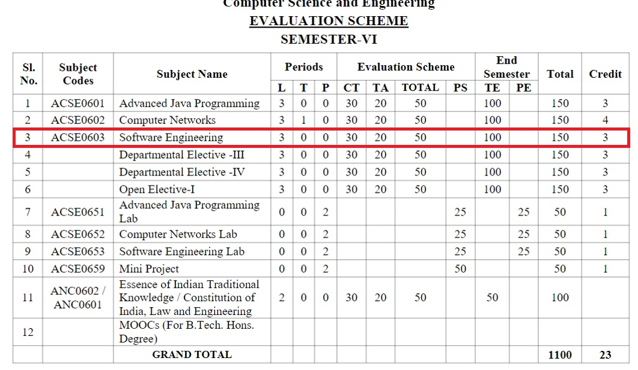
Evaluation Scheme

Slide 4
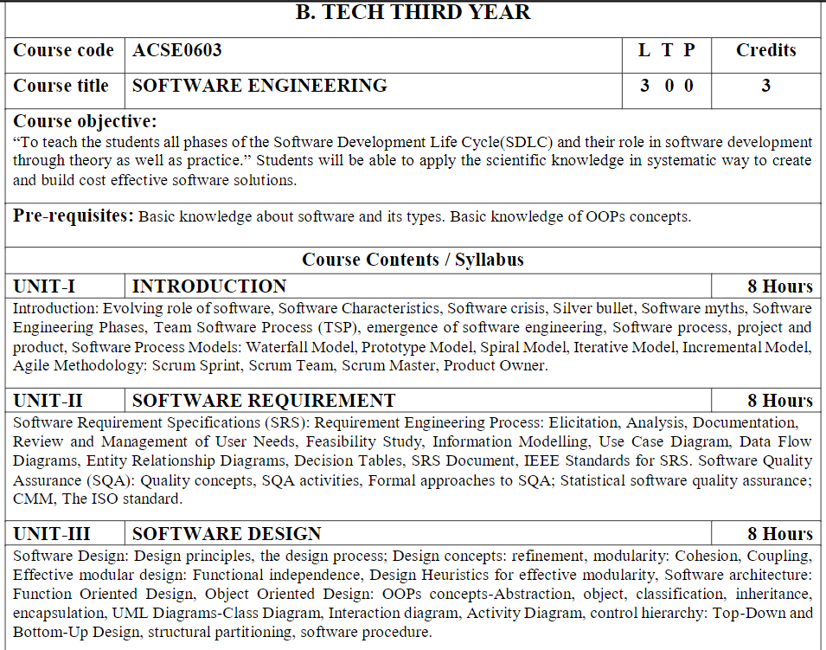
Syllabus

Slide 5
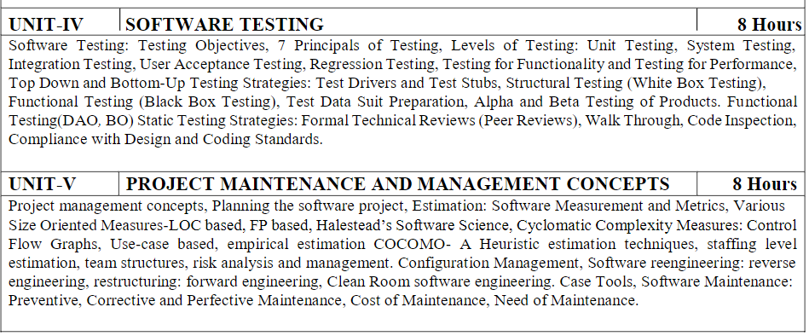
Syllabus

Slide 6
Branch wise Applications
Software engineering applications are new idea, device or process. Innovations are the application of better solutions that meet new requirements, in articulated needs or existing market needs.
The exhaustive and widespread use of computers and the improvements in database technology have provided large data.
The emerging growth of data in databases has generated an urgent need for efficient data mining techniques to discover useful informational knowledge.

Slide 7

Course Objective(unit-2)
An understanding of software requirements and SRS document.
An understanding of implementation issues such as software Quality Frameworks, ISO 9000 Models, and SEI-CMM Model.

Slide 8
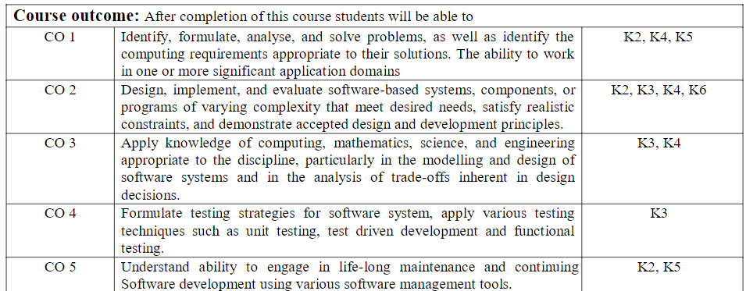
Course Outcome

Slide 9
Program Outcomes (PO)
PO1: Engineering Knowledge
PO2: Problem Analysis
PO3: Design/Development of solutions
PO4: Conduct Investigations of complex problems
PO5: Modern tool usage
PO6: The engineer and society
PO7: Environment and sustainability
PO8: Ethics
PO9: Individual and team work
PO10: Communication
PO11: Project management and finance
PO12: Life-long learning

Slide 10

CO-PO Mapping
CO-PO Correlation Matrices
Correlation levels are taken 1, 2 and 3 as defined below:
1: Slight (Low) 2: Moderate (Medium) 3: Substantial (High)
Software Engineering (Code: ACSE0603)
CO | PO1 | PO2 | PO3 | PO4 | PO5 | PO6 | PO7 | PO8 | PO9 | PO10 | PO11 | PO12
ACSE0603.1 | 3 | 3 | 2 | 2 | 2 | - | - | - | - | - | - | 1
ACSE0603.2 | 3 | 3 | 3 | 3 | 2 | - | - | 2 | 2 | 1 | - | 2
ACSE0603.3 | 3 | 3 | 3 | 3 | 2 | - | 1 | 2 | 2 | 1 | 2 | 2
ACSE0603.4 | 3 | 3 | 3 | 3 | 2 | 2 | 1 | 2 | 2 | 1 | 2 | 2
ACSE0603.5 | 3 | 3 | 3 | 3 | 2 | 2 | 2 | - | 3 | 3 | 2 | 3

Slide 11
Program Specific Outcomes(PSO)
On successful completion of graduation degree the Engineering
graduates will be able to:
PSO1: The ability to identify, analyze real world problems and design
their ethical solutions using artificial intelligence, robotics,
virtual/augmented reality, data analytics, block chain technology,
and cloud computing.
PSO2:The ability to design and develop the hardware sensor devices
and related interfacing software systems for solving complex
engineering problems.
PSO3:The ability to understand inter disciplinary computing
techniques and to apply them in the design of advanced computing.
PSO4: The ability to conduct investigation of complex problem with
the help of technical, managerial, leadership qualities, and modern engineering tools provided by industry sponsored laboratories.

Slide 12
CO-PSO Mapping
CO-PO Correlation Matrices
Correlation levels are taken 1, 2 and 3 as defined below:
1: Slight (Low) 2: Moderate (Medium) 3: Substantial (High)
 | PSO1 | PSO2 | PSO3 | PSO4
ACSE0603.1 | 3 | 3 | 3 | 3
ACSE0603.2 | 3 | 3 | 3 | 3
ACSE0603.3 | 2 | 2 | 2 | 2
ACSE0603.4 | 3 | 3 | 3 | 3
ACSE0603.5 | 2 | 2 | 2 | 2
Average | 2.6 | 2.6 | 2.6 | 2.6

Slide 13
Program Educational Objectives
PEO1: To have an excellent scientific and engineering breadth so as to
comprehend, analyze, design and provide sustainable solutions for
real-life problems using state-of-the-art technologies.
PEO2:To have a successful career in industries, to pursue higher studies or
to support enterpreneurial endeavors and to face global challenges.
PEO3:To have an effective communication skills, professional attitude,
ethical values and a desire to learn specific knowledge in emerging
trends, technologies for research, innovation and product
development and contribution to society.
PEO4: To have life-long learning for up-skilling and re-skilling for
successful professional career as engineer, scientist, enterpreneur
and bureaucrat for betterment of society

Slide 14
CO-PEO Mapping
Program Educational Objectives and Course Outcomes Mapping
CO | PEO1 | PEO2 | PEO3 | PEO4
CO1 | 3 | 3 | 3 | 3
CO2 | 3 | 3 | 3 | 3
CO3 | 2 | 2 | 2 | 2
CO4 | 3 | 3 | 3 | 3
CO5 | 2 | 2 | 2 | 2
*3= High *2= Medium *1=Low

Slide 15
Result Analysis
Subject Result = 100%

Slide 16
End Semester Question Paper Templates
B TECH
(SEM-V) THEORY EXAMINATION 20__-20__
SOFTWARE ENGINEERING
Time: 3 Hours Total Marks: 100
Note: 1. Attempt all Sections. If require any missing data; then choose suitably.
SECTION A
Attempt all questions in brief. 1 x 10 = 10
Q.No. | Question | Marks | CO
1 |  | 2
2 |  | 2
. |  | .
10 |  | 2

Slide 17
End Semester Question Paper Templates
SECTION A
2. Attempt all questions in brief. 2 x 5 = 10
Q.No. | Question | Marks | CO
1 |  | 2
2 |  | 2
. |  | .
5 |  | 2

Slide 18
End Semester Question Paper Templates
SECTION B
3. Attempt any five of the following: 5 x 6 = 30
SECTION C
4. Attempt any one part of the following: 1 x 10 = 10
Q.No. | Question | Marks | CO
1 |  | 6
2 |  | 6
. |  | .
7 |  | 6
Q.No. | Question | Marks | CO
1 |  | 10
2 |  | 10

Slide 19
Prerequisite/Recap
A Scripting Language
A Version Control Tool
Code Editors & IDEs (Integrated Development Environment)
Databases
Networking
Software Development Life Cycle (SDLC)
Basic Programming Skills
Innovative Thinking.
Enthusiasm to learn Management concepts.

Slide 20
Stakeholders and Requirements (Bridging Content)
Stakeholder :. The term “stakeholder” in software engineering refers to people or groups that are affected directly or indirectly by a software. In any case, they are interested in the final product. Examples are end user, developer, tester, coder etc.
User Requirements
User requirement are written for the users and include functional and non-functional requirement.
System Requirements
System requirement are derived from user requirement.
The user system requirements are the parts of software requirement and specification (SRS) document.

Slide 21
User Requirement Types
Known Requirements :
something a stakeholder believes to be implemented.
Unknown Requirement :
forgotten by the stakeholder because they are not needed right now or needed only by another stakeholder.
Undreamed Requirement :
stakeholder may not be able to think of new requirements due to limited domain knowledge.

Slide 22
Type of Requirement
Known, unknown, undreamed requirements may be functional or non- functional.
Functional Requirements (What the system should do?)
it is related to the expectations from the intended s/w.
It describe what the s/w has to do.
Sometimes it may also specify what the s/w should not do.
Non-Functional Requirements (How well the system should perform?)
It is mostly quality requirements that stipulate how well the s/w does what it has to do.
For user includes specification of performance, availability, usability and flexibility.
For developers are maintainability, portability and testability.

Slide 23
Examples of Requirements
Example: Online Food Delivery System
1. Functional Requirements
These define specific functionalities that the system must provide.
✅ Functional Requirements:
Users should be able to register and log in using email or phone number.
The system should allow users to browse restaurants based on location and cuisine.
Users should be able to add food items to the cart and place an order.
The system should provide multiple payment options (Credit Card, UPI, Wallet, Cash on Delivery).
The system should send real-time notifications for order updates (Order Placed, Order Out for Delivery, Order Delivered).
Users should be able to track the delivery person’s location in real-time.
2. Non-Functional Requirements
These define system qualities such as performance, security, usability, and scalability.
✅ Non-Functional Requirements:
The system should load the homepage within 2 seconds under normal traffic conditions.
The app should support at least 100,000 concurrent users without crashing.
All payment transactions should be encrypted using SSL/TLS for security.
The system should be available 99.9% of the time to ensure reliability.
The mobile app should be compatible with Android (version 8 and above) and iOS (version 12 and above).
The system should automatically log out users after 10 minutes of inactivity to enhance security.

Slide 24
Requirement Engineering (CO2)
Requirements engineering (RE) refers to the process of defining, documenting, and maintaining requirements in the engineering design process.
It describe the “What” of a system, not the “How”.
It’s input is problem statement prepared by the customer.
It produces one large document (SRS), written in natural language, contain the description of what the system will do without describing how it will do.
It’s process consists four steps:
Requirement Elicitation.
Requirement Analysis.
Requirement Documentation.
Requirement Review.

Slide 25
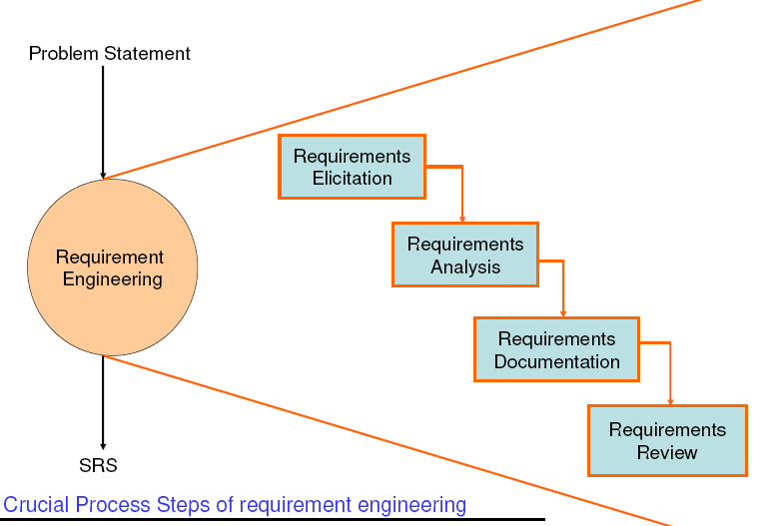
Requirement Engineering (CO2)

Slide 26
Requirement Engineering Process (CO2)
Requirement Elicitation(Extraction)
It is known as requirement gathering.
Requirement is identified with the help of customer and existing system process.
Requirement Analysis
It starts with requirement elicitation.
It perform to identify inconsistencies, defects, etc.
Requirement Documentation
It is the end product of 1 and 2. known as SRS.
Document provides the foundation of s/w design.
SRS may act as a contract between developer and customer.
Requirement Review
It is carried out to improve the quality of SRS.
It may also be called as requirement verification.

Slide 27
Requirement Elicitation (CO2)
It is most important goal of RE to find out what users really need.
It is ability that helps to understand the problem to be solved.
It is conduct by asking que., writing down answers, asking other que., etc.
Developers and users have different mind set, expertise and vocabularies so there are chances of conflicts that may led to inconsistencies, misunderstanding and omission of requirements .
It requires the collaboration of several groups of participants who have different background.

Slide 28
Requirement Elicitation Methods
Interviews.
Brainstorming Sessions.
Facilitated Application Specification Technique (FAST)
Quality Function Deployment.
The use Case Approach.

Slide 29
Interviews
Interviews :
Objective of conducting an interview is to understand the customer’s expectations from the software. It is impossible to interview every stakeholder hence representatives from groups are selected based on their expertise and credibility.
Interviews maybe be open-ended or structured.
In open-ended interviews there is no pre-set agenda. Context free questions may be asked to understand the problem.
In structured interview, agenda of fairly open questions is prepared. Sometimes a proper questionnaire is designed for the interview.

Slide 30
Brainstorming Sessions
Brainstorming Sessions :
It is a group technique.
It is intended to generate lots of new ideas hence providing a platform to share views
A highly trained facilitator is required to handle group bias and group conflicts.
Every idea is documented so that everyone can see it.
Finally, a document is prepared which consists of the list of requirements and their priority if possible.

Slide 31
Facilitated Application Specification Technique(FAST)
Facilitated Application Specification Technique: It’s objective is to bridge the expectation gap – difference between what the developers think they are supposed to build and what customers think they are going to get.
A team oriented approach is developed for requirements gathering. Each attendee is asked to make a list of objects that are-
Part of the environment that surrounds the system
Produced by the system
Used by the system
Each participant prepares his/her list, different lists are then combined, redundant entries are eliminated, team is divided into smaller sub-teams to develop mini-specifications and finally a draft of specifications is written down using all the inputs from the meeting.

Slide 32
Quality Function Deployment
Quality Function Deployment: In this technique customer satisfaction is of prime concern, hence it emphasizes on the requirements which are valuable to the customer. 3 types of requirements are identified –
Normal requirements – In this the objective and goals of the proposed software are discussed with the customer. Example – normal requirements for a result management system may be entry of marks, calculation of results, etc
Expected requirements – These requirements are so obvious that the customer need not explicitly state them. Example – protection from unauthorized access.
Exciting requirements – It includes features that are beyond customer’s expectations and prove to be very satisfying when present. Example – when unauthorized access is detected, it should backup and shutdown all processes.

Slide 33
Quality Function Deployment
Quality Function Deployment is a methodical approach used in product development to ensure that customer needs are accurately captured and translated into specific product features and characteristics. It originated in Japan in the 1960s and has since become a widely adopted practice in various industries worldwide.
Identifying Customer Requirements:
The first step in QFD is to identify and prioritize customer requirements. This involves gathering data through techniques such as surveys, interviews, focus groups, and market research to understand what customers value and expect from the product.
Developing the House of Quality (HOQ):The House of Quality is a key tool in QFD. It is a matrix that visually represents the relationship between customer requirements and technical features of the product.
The HOQ typically consists of the following components:
Customer Requirements: These are the needs, preferences, and expectations of the customers. They are usually listed on the left side of the matrix.

Slide 34
Quality Function Deployment
Technical Requirements: These are the specific characteristics or attributes of the product that will satisfy the customer requirements. They are listed across the top of the matrix.
Relationship Matrix: This section of the HOQ shows the strength of the relationship between each customer requirement and technical requirement. It is filled in based on input from cross-functional teams and subject matter experts.
Prioritization Scales: These scales are used to assign relative importance or priority to each customer requirement and technical requirement. They help in focusing efforts on the most critical aspects of the design.
Translating Customer Requirements into Engineering Characteristics:
Once the House of Quality is completed, the next step is to translate customer requirements into specific engineering characteristics or design parameters. This involves brainstorming and identifying potential design solutions that address the technical requirements identified in the HOQ.
Implementing Design Changes: Based on the results of the QFD process, design changes and improvements are implemented to align the product with customer needs and preferences. This may involve refining existing features, adding new features, or modifying the product design to better meet customer expectations.
Continuous Improvement: QFD is not a one-time activity but rather an iterative process that involves continuous improvement. As customer needs and market conditions change, organizations use feedback from customers and performance data to refine their products and processes, ensuring ongoing satisfaction and competitiveness.

Slide 35
Quality Function Deployment
Quality Function Deployment :
The major steps involved in this procedure are –
Identify all the stakeholders, eg. Users, developers, customers etc
List out all requirements from customer.
A value indicating degree of importance is assigned to each requirement.
In the end the final list of requirements is categorized as –
It is possible to achieve
It should be deferred and the reason for it
It is impossible to achieve and should be dropped off

Slide 36
Quality Function Deployment
5 Points : Very Important
4 Points : Important
3 Points : Not Important but nice to have
2 Points : Not important
1 Points : Unrealistic, required further, exploration
Final list of requirements categorize like:
(i) It is possible to achieve
(ii) It should be deferred & Why
(iii) It is impossible and should be dropped from consideration
First Category requirements will be implemented as per priority assigned with every requirement.

Slide 37
Use Case Approach
This technique combines text and pictures to provide a better understanding of the requirements. The use cases describe the ‘what’, of a system and not ‘how’. Hence, they only give a functional view of the system. The components of the use case design includes three major things – Actor, Use cases, use case diagram.
Actor – It is the external agent that lies outside the system but interacts with it in some way. An actor maybe a person, machine etc. It is represented as a stick figure. Actors can be primary actors or secondary actors.
Primary actors – It requires assistance from the system to achieve a goal.
Secondary actor – It is an actor from which the system needs assistance.

Slide 38
Use Case Approach
2. Use cases – They describe the sequence of interactions between actors and the system. They capture who(actors) do what(interaction) with the system. A complete set of use cases specifies all possible ways to use the system.
3. Use case diagram – A use case diagram graphically represents what happens when an actor interacts with a system. It captures the functional aspect of the system.
A stick figure is used to represent an actor.
An ellipse is used to represent a use case.
A line is used to represent a relationship between an actor and a use case.

Slide 39
Use case Diagram
-- represents what happens when actor interacts with a system.
-- captures functional aspect of the system.
Relationship between actors and use case and/or between the use cases.
Use Case
Actor
-- Actors appear outside the rectangle.
--Use cases within rectangle providing functionality.
--Relationship association is a solid line between actor & use cases.

Slide 40
Use Case Template
Introduction: Describe a quick background of the use case.
Actors : List the actors that interact and participate in the use cases.
Pre Conditions : Pre conditions that need to be satisfied for the use case to perform.
Post Conditions : Define the different states in which we expect the system to be in, after the use case executes.

Slide 41
Use Case Template
Flow of events
Basic Flow : List the primary events that will occur when this use case is executed.
Alternative Flows: Any Subsidiary events that can occur in the use case should be separately listed. List each such event as an alternative flow. A use case can have many alternative flows as required.
Special Requirements : Business rules will be used for writing test cases. Both success and failures scenarios should be described.
Use Case relationships : For Complex systems Listing the relationships between use cases also provides a mechanism for traceability

Slide 42
Use Case Guidelines
Use Case Template
Identify all users.
Create a user profile for each category of users including all roles of the users play that are relevant to the system.
Create a use case for each goal, following the use case template maintain the abstraction throughout the use case.
Structure the use case.
Review and validate with users.

Slide 43
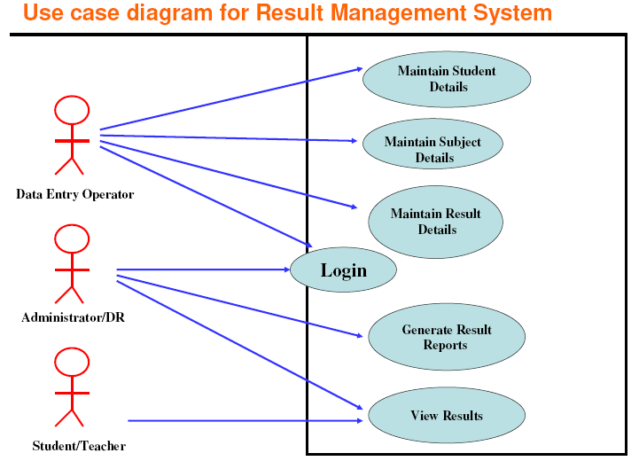
Cont..

Slide 44
Login(Template)
Login
1.1 Introduction : This use case describes how a user logs into the Result Management System.
1.2 Actors : (i) Data Entry Operator
(ii) Administrator/Deputy Registrar
1.3 Pre Conditions : None
1.4 Post Conditions :
If the use case is successful, the actor is logged into the system. If not, the system state is unchanged.

Slide 45
Login(Template)
1.5 Basic Flow : This use case starts when the actor wishes to login to the Result Management system.
(i) System requests that the actor enter his/her name and password.
(ii) The actor enters his/her name & password.
(iii) System validates name & password, and if finds correct allow the actor to logs into the system.

Slide 46
Login(Template)
1.6 Alternate Flows
1.6.1 Invalid name & password
If in the basic flow, the actor enters an invalid name and/or password, the system displays an error message. The actor can choose to either return to the beginning of the basic flow or cancel the login, at that point, the use case ends.
1.7 Special Requirements: None
1.8 Use case Relationships: None

Slide 47
Requirement Analysis (CO2)
We analyze, refine and scrutinize gathered requirements to make consistent & unambiguous requirements.
Activity reviews all the requirement ands may Provide graphical view of the entire system.
May also interact with customer to resolve their confusion and find priority of requirements.

Slide 48
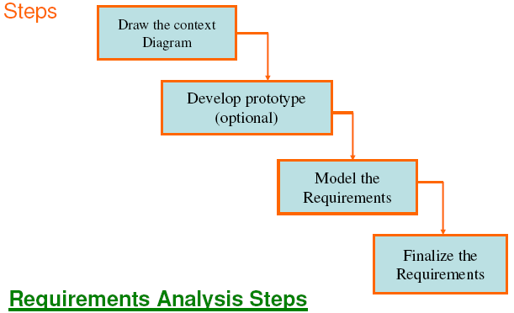
Steps of Requirement Analysis

Slide 49
Context Diagram
A context diagram is a high-level view of a system. It’s a basic sketch meant to define an entity based on its scope, boundaries, and relation to external components like stakeholders.

Slide 50
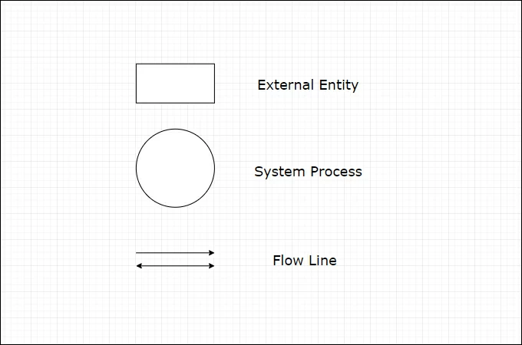
Symbols used in Context Diagram
External Entity- an element in the system diagram that inputs data into the information system and retrieves processed data.
Process- refers to the entire process of the system. This is responsible for processing and distributing information to the entities of the system context diagram.
Flow Line- this element depicts the flow of the data within the system. It is supported by text to show what type of data is being sent.

Slide 51
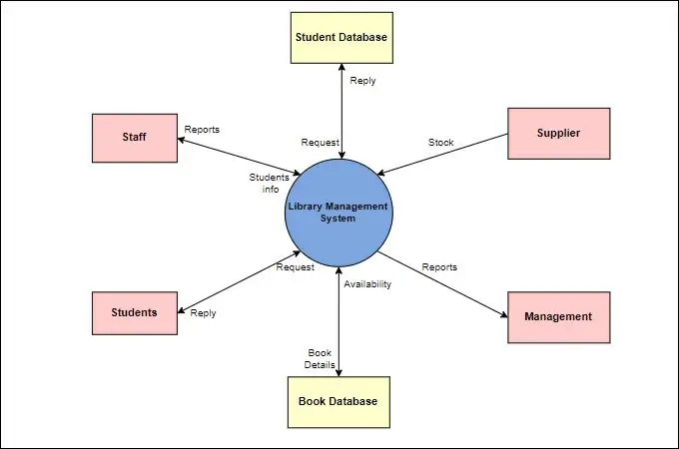
Symbols used in Context Diagram

Slide 52
Benefits of using Context Diagram
The diagram does not show any details regarding the technical structure.
It is one of the best illustrations to present your business project. This way you can clearly explain the project to an audience with no technical knowledge.
A system context diagram is an excellent tool for any line of business that needs an automated system of services.

Slide 53
Development of Prototype(Optional)
It is effective way to find out what the customer really want.
We take customer feedback to continuously modify the prototype until he/she is satisfied.
It should be built quickly and at a relatively low cost.
Due to its limitations and would not be acceptable in final system it is an optional activity.
Many organization are developing prototypes for better understanding before the finalization of SRS.

Slide 54
Model the Requirement
This process consists of various graphical representation of functions, data entities, external entities and relationship between them.
Graphical view help us to find incorrect, missing, and inconsistent requirements.
Such models includes
Data flow diagram
Entity Relationship Diagram(ERD)
Data Dictionary
Decision Table, etc.

Slide 55
Finalize the Requirements
After modeling the requirements, we will have better understanding of the system behavior.
Inconsistencies and ambiguities have been identified.
Now we finalize the analyzed requirements and next step is to document these requirements in a prescribed format

Slide 56
Data Flow Diagrams(CO2)
Also known as data flow graph or bubble chart.
It shows the flow the data through a system.
It represent a systems in terms of input data to the system, various processing carried out on those data, and the output data generated by the system.
System may be an organization, a set of procedures, a computer H/W system, a s/w system, etc.
In DFD
All names should be unique.
It is not a flow chart. Arrow represent flowing of data without any order.
Suppress logical decisions.
Defer error conditions & handling until the end of the analysis.

Slide 57
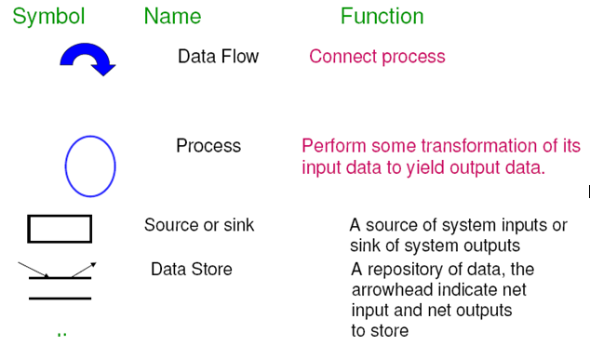
DFD

Slide 58
Developing DFD model of a system
Step1: Construction of context diagram. It a top level DFD , usually called 0 level DFD.(A level 0 DFD is called fundamental system model or context model represents entire software element as a single bubble with input and output data indicating by incoming & outgoing arrows.)
Step2: Construction of level1 DFD. Expend the process of context diagram.
Step3: Construction of lower level DFD. Decompose the process of level 1 DFD recursively.

Slide 59
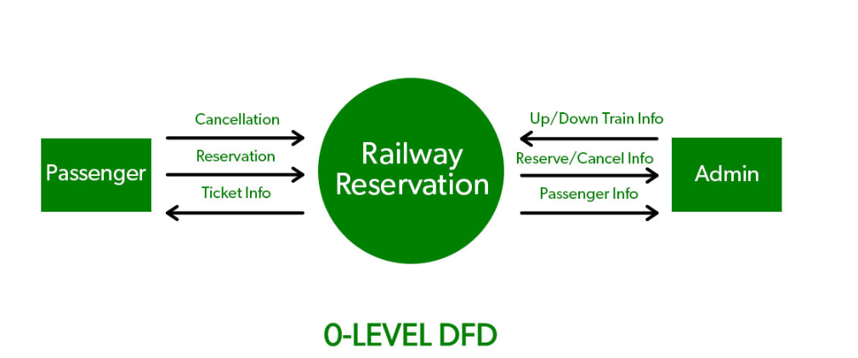
0 Level DFD

Slide 60
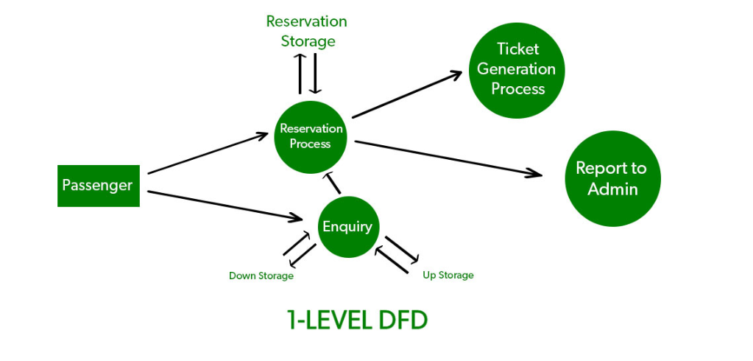
1 Level DFD

Slide 61
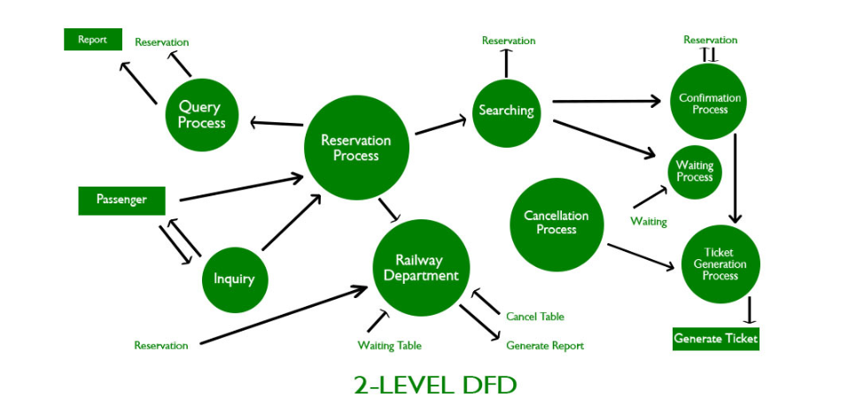
2 Level DFD

Slide 62
Data Dictionary
Data Dictionary is the major component in the structured analysis model of the system. It lists all the data items appearing in DFD. A data dictionary in Software Engineering means a file or a set of files that includes a database’s metadata (hold records about other objects in the database), like data ownership, relationships of the data to another object, and some other data. Case Tools is used to maintain data dictionary as it captures the data items appearing in a DFD automatically to generate the data dictionary.
Case tools: CASE illustrates a wide set of labor-saving tools that are used in software development.

Slide 63
Data Dictionary
It is an organized collection of all the data elements of the system and their brief description
Includes :
Name of data item
Aliases (other names for items)
Description/Purpose
Related data items
Range of values
Data flows
Data structure definition

Slide 64
Features of Data Dictionary
It helps in designing test cases and designing the software.
It is very important for creating an order list from a subset of the items list.
It is very important for creating an order list from a complete items list.
The data dictionary is also important to find the specific data item object from the list.

Slide 65
Uses of Data Dictionary
Used for creating the ordered list of data items
Used for creating the ordered list of a subset of the data items
Used for Designing and testing software in Software Engineering
Used for finding data items from a description in Software Engineering

Slide 66
Importance of Data Dictionary
It provides developers with standard terminology for all data.
It provides developers to use different terms to refer to the same data.
It provides definitions for different data
Query handling is facilitated if a data dictionary is used in RDMS.

Slide 67
Advantages of Data Dictionary
Advantage of Data Dictionary
Consistency and Standardization: A data dictionary helps to ensure that all data elements and attributes are consistently defined and named across the organization, promoting standardization and consistency in data management practices.
Data Quality: A data dictionary can help improve data quality by providing a single source of truth for data definitions, allowing users to easily verify the accuracy and completeness of data.
Data Integration: A data dictionary can facilitate data integration efforts by providing a common language and framework for understanding data elements and their relationships across different systems. Improved Collaboration: A data dictionary can help promote collaboration between business and technical teams by providing a shared understanding of data definitions and structures, reducing misunderstandings and communication gaps.
Improved Efficiency: A data dictionary can help improve efficiency by reducing the time and effort required to define, document, and manage data elements and attributes.

Slide 68
Disadvantage of Data Dictionary
Implementation and Maintenance Costs: Implementing and maintaining a data dictionary can be costly, requiring significant resources in terms of time, money, and personnel.
Complexity: A data dictionary can be complex and difficult to manage, particularly in large organizations with multiple systems and data sources.
Resistance to Change: Some stakeholders may be resistant to using a data dictionary, either due to a lack of understanding or because they prefer to use their own terminology or definitions.
Data Security: A data dictionary can contain sensitive information, and therefore, proper security measures must be in place to ensure that unauthorized users do not access or modify the data.
Data Governance: A data dictionary requires strong data governance practices to ensure that data elements and attributes are managed effectively and consistently across the organization.

Slide 69
Case Study
Create a data dictionary of online bookstore (Book, Customer, Order, and Order_Item) and their respective attributes in an online bookstore system. It provides a clear overview of the data structure and relationships within the system, facilitating development, maintenance, and usage.

Slide 70
Book
Attributes:
Book_ID (Primary Key)
Title
Author
Genre
Price
Publication_Year
ISBN
Description
Customer
Attributes:
Customer_ID (Primary Key)
Name
Email
Address
Phone_Number
Order
Attributes:
Order_ID (Primary Key)
Customer_ID (Foreign Key)
Date
Total_Amount
Order_Item
Attributes:
Order_Item_ID (Primary Key)
Order_ID (Foreign Key)
Book_ID (Foreign Key)
Quantity
Subtotal

Slide 71
Advantage
Advantage:
Define data items unambiguously.
Valuable reference in any organization because it provides documentation.
It is a good tool for different stakeholder to understand the requirements and designs.
It store the information of all data items that can link to all phases of SDLC.
It is an important step in building a database. Most of DBMS have a data dictionary as a standard format.

Slide 72
ER Diagram (CO2)
It is a detailed logical representation of data for an organization and uses three main constructs.
Entities
Fundamental thing about which data may be maintained. Each entity has its own identity.
Entity Type is the description of all entities to which a common definition and common relationships and attributes apply.

Slide 73
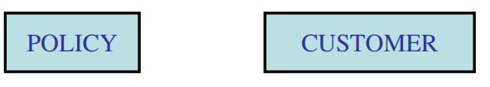
ER Diagram
It is a detailed logical representation of data for an organization and uses three main constructs.
Entities
Fundamental thing about which data may be maintained. Each entity has its own identity.
Entity Type is the description of all entities to which a common definition and common relationships and attributes apply.

Slide 74
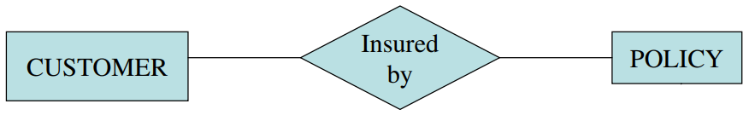
ER Diagram
Relationships
A relationship is a reason for associating two entity types. Binary relationships involve two entity types
A CUSTOMER is insured by a POLICY.
Relationships are represented by diamond notation in a ER diagram

Slide 75
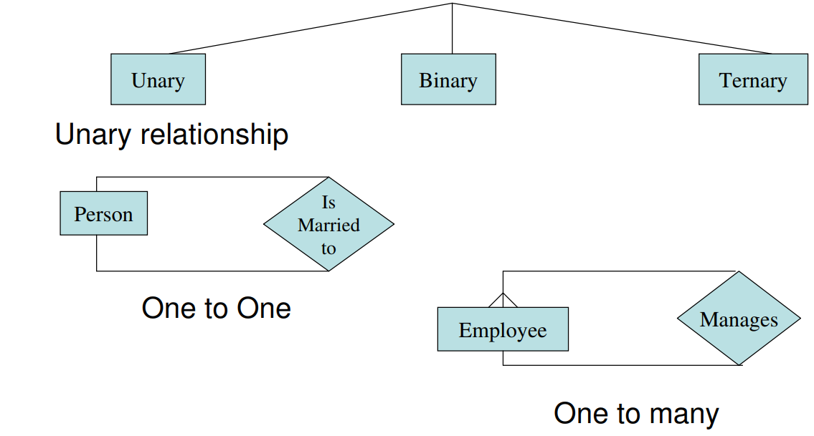
ER Diagram
Degree of relationship

Slide 76
Decision Table(CO2)
It is a tabular form that presents a set of conditions and their corresponding actions.
There four portion of decision table.
Condition | Condition Alternatives
Actions | Actions Entries

Slide 77
Decision Table
2-Dim. Matrix:
Row1 : for each possible actions.
Row2: for each relevant conditions.
One column for each combination of condition states.
Upper rows specify the variables or conditions to be evaluated and lower rows specify the corresponding actions to be taken when an evaluation test is satisfied
A column in a decision table is called a rule. It implies if a condition is true then execute the corresponding action.

Slide 78
Decision Table
Loan Approval Decision Table
Imagine a bank wants to automate loan approvals based on the following conditions:
C1: Applicant has a stable job.
C2: Applicant has a good credit score.
C3: Applicant has an existing loan.
Actions:
A1: Approve loan
A2: Approve with conditions
A3: Reject loan

Slide 79
Decision Table
How to Read the Table
Rule 1: If the applicant has a stable job and good credit but no existing loan, the loan is approved.
Rule 2: If the applicant has a stable job but a poor credit score, and an existing loan, the loan is approved with conditions.
Rule 3: If the applicant has no job but good credit and an existing loan, the loan is approved with conditions.
Rule 4: If the applicant has a stable job but poor credit and has an existing loan, the loan is rejected.

Slide 80
Decision Table
Conditions | Rule 1 | Rule 2 | Rule 3 | Rule 4
Stable Job (C1) | ✅ | ✅ | ❌ | ✅
Good Credit (C2) | ✅ | ❌ | ✅ | ❌
Existing Loan (C3) | ❌ | ✅ | ✅ | ✅
Actions
Approve Loan (A1) | ✅ | ❌ | ❌ | ❌
Approve with Conditions (A2) | ❌ | ✅ | ✅ | ❌
Reject Loan (A3) | ❌ | ❌ | ❌ | ✅

Slide 81
Requirement Documentation (CO2)
The two scenario create entirely different situation and establish entirely different purposes for the document.
First case SRS is used to define the needs and expectations of the user. Second case ,SRS is written for different purpose and serve as a contract document between customer and developer.

Slide 82
SRS Document(CO2)
Requirement document is called software requirement specification(SRS). The SRS is a specification for a particular software product program or set of program that perform certain functions in a specific environment. It serves a number of purposes depending on who is writing it. First the SRS could be written by the customer of a system. Second the SRS could be written developer of a system.

Slide 83
Characteristics of SRS
Complete: The SRS should include all the requirements for the software system, including both functional and non-functional requirements.
Consistent: The SRS should be consistent in its use of terminology and formatting, and should be free of contradictions.
Unambiguous: The SRS should be clear and specific, and should avoid using vague or imprecise language.
Traceable: The SRS should be traceable to other documents and artifacts, such as use cases and user stories, to ensure that all requirements are being met.
Verifiable: The SRS should be verifiable, which means that the requirements can be tested and validated to ensure that they are being met.
Modifiable: The SRS should be modifiable, so that it can be updated and changed as the software development process progresses.
Prioritized: The SRS should prioritize requirements, so that the most important requirements are addressed first.

Slide 84
Characteristics of SRS
Testable: The SRS should be written in a way that allows the requirements to be tested and validated.
High-level and low-level: The SRS should provide both high-level requirements (such as overall system objectives) and low-level requirements (such as detailed functional requirements).
Relevant: The SRS should be relevant to the software system that is being developed, and should not include unnecessary or irrelevant information.
Human-readable: The SRS should be written in a way that is easy for non-technical stakeholders to understand and review.
Aligned with business goals: The SRS should be aligned with the overall business goals and objectives of the organization, so that the software system meets the needs of the business.
Agile methodologies: Agile methodologies, such as Scrum and Kanban, provide an iterative approach to requirements capturing and validation, where requirements are captured and validated in small chunks of functionality and feedback is gathered from the customer.

Slide 85
Organization of the SRS (CO2)
IEEE has published guidelines and standards to organize an SRS.
First two sections are same. The specific tailoring occurs in section-3.
Introduction
1.1 Purpose
1.2 Scope
1.3 Definition, Acronyms and abbreviations
1.4 References
1.5 Overview

Slide 86
Organization of the SRS
2. The Overall Description 2.1 Product Perspective 2.1.1 System Interfaces 2.1.2 Interfaces 2.1.3 Hardware Interfaces 2.1.4 Software Interfaces 2.1.5 Communication Interfaces 2.1.6 Memory Constraints 2.1.7 Operations 2.1.8 Site Adaptation Requirements

Slide 87
Organization of the SRS
2.2 Product Functions 2.3 User Characteristics 2.4 Constraints 2.5 Assumptions for dependencies 2.6 Apportioning of requirements

Slide 88
Organization of the SRS
3. Specific Requirements
3.1 External Interfaces
3.2 Functions
3.3 Performance requirements
3.4 Logical database requirements
3.5 Design Constraints
3.6 Software System attributes
3.7 Organization of specific requirements
3.8 Additional Comments.
4. External Interface Requirements
5. Non functional Requirements

Slide 89
Requirement validation (CO2)
After completion of SRS Check the document for
Completeness & consistency
Conformance to standards
Requirements conflicts
Technical errors
Ambiguous requirements
Objective of requirement validation is to certify the SRS document, Is an acceptable document of the system to be implemented.
It find the error in document and improves the quality of s/w development process.
Analysis: work with raw requirement as collected from various stakeholder
Validation: work with a final draft of the SRS document with negotiated and agreed requirements.

Slide 90
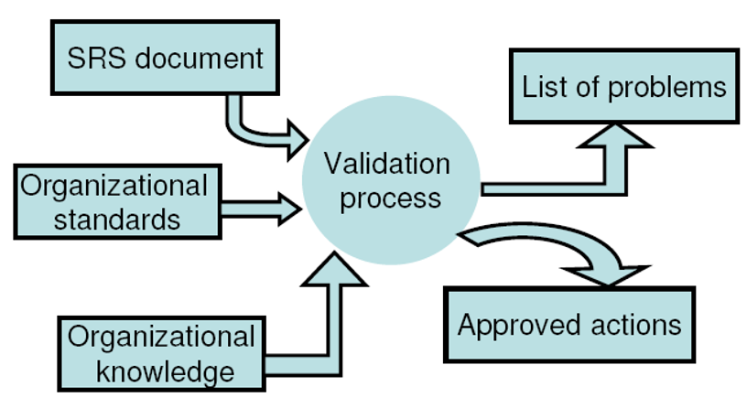
Requirement Validation

Slide 91
Requirement Review (CO2)
Plan review: review team is selected, time and place is fixed for review meeting.
Distributed SRS doc: each member should read doc. To find conflict, inconsistencies, deviations and other problems.
Organize review meeting: each member present his/her view, problem are discussed and action on them are approved.
Follow-up actions: chairperson of team checks that approved action have been carried out
Revise SRS doc: SRS doc. Is revised to reflect the approved actions

Slide 92
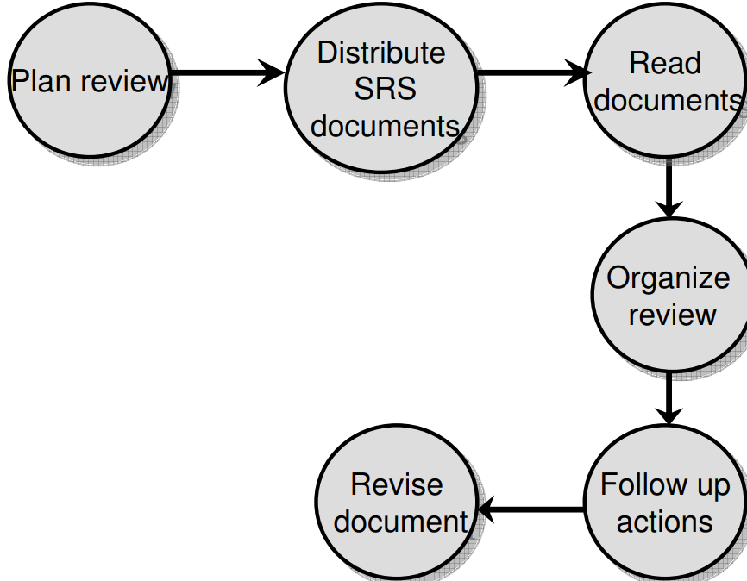
Requirement Review Process

Slide 93
Management of User Need
User Requirement Document (URD) :
It is used in SE, That specify the req. the use expect from software.
After URD customer can not demand extra feature similarly developer cannot claim the product ready until it does not meet URD.
Types of requirements:
Enduring requirements: They are core requirements & are related to main activity of the organization. Example: in library management. System issue/return of a book, cataloging etc.
Volatile requirements: likely to change during software development lifer cycle or after delivery of the product .
.

Slide 94
Management of User Need
Reason for change are:
Change in environment.
Change in Technology.
Change in policies.
Change in customer’s expectations.

Slide 95
Requirements Management
It is the process of documenting, analyzing, tracing, prioritizing, and controlling requirement requirements throughout the development lifecycle of a project.
Requirements Management : Process of understanding and controlling changes to system requirements.
Requirement change Mgmt. process can be applied in three Stages:
Problem Analysis and Change Specification : change request made for partial problem then change specification are analyzed in order to validate the req. change
Change Analysis and Costing: estimate cost of change then take decision to implement it or not.
Change Implementation: when decide to change in req. Req doc. Is re-written or re-organized.

Slide 96
Verification and Validation(CO2)
The purpose of V & V is to confirm system specification and to meet the requirement of system customers.
Verification: represent the set of activities that are carried out to confirm that the s/w correctly implemented the specific functionality.(are we building the product right?)
It is the process of determining whether the output of one phase of software development conforms to that of its previous phase. Thus verification is concerned with phase containment of errors
Validation: represent set of activities that ensure that the s/w that has been build is satisfying the customer requirements.(are we building the right product?)
It is the process of determining whether a fully developed system conforms to its requirements specification. the aim of validation is that the final product be error free.

Slide 97
Software Quality Assurance(CO2)
SQA is a process ensuring software products meet quality standards and requirements.
It is a set of activities that are designed to evaluate the process by which s/w developed and/or maintained.
The aim of this process is to develop high quality s/w product.
SQA objectives
Defect Prevention: To identify and prevent defects or issues in the software development process before they occur.
Process Improvement: To evaluate and enhance the software development process to make it more efficient, reliable, and effective.
It involves analyzing processes, identifying bottlenecks, and implementing improvements to optimize the development lifecycle.
Compliance: software development follows industry standards, regulations, and guidelines.
It aims to comply with various quality frameworks, such as ISO 9001 or CMMI, to maintain consistency, reliability, and interoperability.

Slide 98
Software Quality Assurance(CO2)
Verification and Validation: SQA focuses on verifying that software meets the specified requirements and validating that it functions as intended. It involves conducting reviews, inspections, and testing to ensure that the software performs accurately and reliably.
Risk Mitigation: SQA aims to identify potential risks and vulnerabilities in the software and mitigate them through proactive measures. By conducting risk assessments and implementing appropriate controls, SQA helps to prevent issues that could lead to software failure or security breaches.
Customer Satisfaction: SQA strives to meet or exceed customer expectations by delivering high-quality software. By continuously monitoring and assessing software quality, SQA ensures that the end product meets the needs of the users, leading to increased customer satisfaction.
Continuous Improvement: SQA promotes a culture of continuous improvement within the software development organization. It involves collecting feedback, analyzing metrics, and learning from past experiences to refine processes and enhance the overall quality of software products.

Slide 99
SQA Plan (CO2)
It consists various tasks which carried out by two groups:
Group1: consist of s/w Engineers who do technical work.
Group2: it is SQA group. Responsible to prepare SQA plan, record keeping, analysis and reporting. It assist s/w team in achieving a high quality end product.
SQA plan provides a road map for SQA.
SQA plan identifies:
evaluations to be performed
audits and reviews to be performed
standards that are applicable to the project
procedures for error reporting and tracking
documents to be produced by the SQA group
amount of feedback provided to the software project team

Slide 100
SQA plan is a three stage process
Stage 1: SQA team should write in detail activities related for s/w requirements.
Stage2: team should analyze in detail the preparation of the development team for detailed build-up.
Stage3: tackles the QA plan for detailed design and actual product.(it is longest among three phases)

Slide 101
Capability Maturity Model(CO2)
It is not a SDLC model.
It is a strategy for improving the software process, irrespective of the actual life cycle model used.
It was developed by S/W Engg. Institute(SEI) of Carnegie-Mellon Univ. in 1996.
It is an assessment that results in a five point/level grading scheme

Slide 102
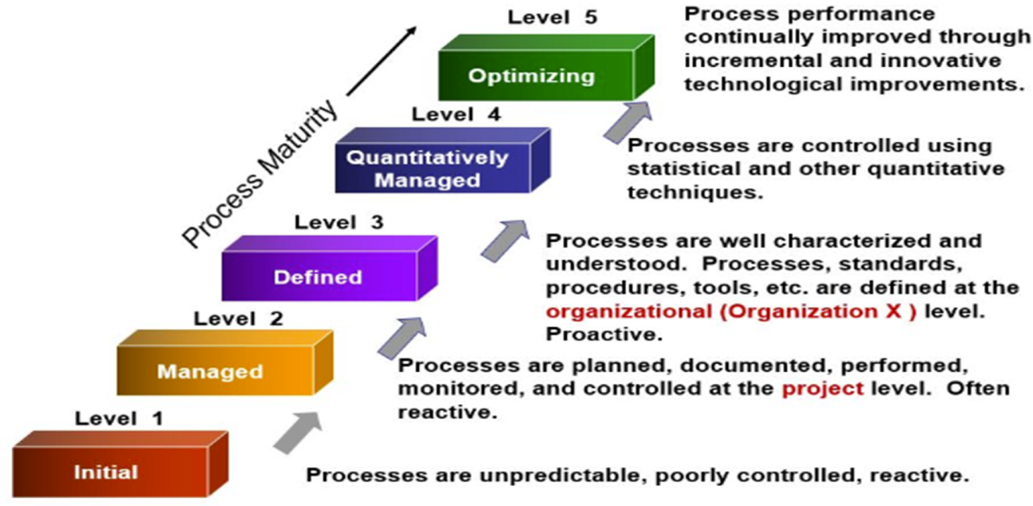
CMM

Slide 103
Maturity Levels
Initial (Maturity Level 1)
The ad hoc software process development.
Very Few or no processes are defined and followed.
Success of project depends on individual effort.
Totally depends on current staff. When developer leave org., successor face great difficulty to understand the process.
No formal project management practices are followed.
It not possible to predict accurate time and cost of s/w product.
Since software production processes are not limited, different engineers follow their process and as a result, development efforts become chaotic. Therefore, it is also called a chaotic level.
Repeatable (Maturity Level 2)
Basic project management process are established to track cost, schedule, and functionality.
The necessary process discipline is in place to repeat earlier success on project with similar application but process is not documented.
In similar project success story of development can be repeated for another.

Slide 104
CMM
Defined (Maturity Level 3)
the methods for both management and development activities are defined and documented.
common organization-wide understanding of operations, roles, and responsibilities.
All project use an documented and approved version of the organization standard s/w process for developing and maintaining s/w.
But the process and practices are not analyzed quantitatively.
Managed (Maturity Level 4)
Both the s/w process and product are quantitatively understood and controlled.
It focus on s/w metrics:
Product metrics: measure the features of the product being developed, such as its size, reliability, time complexity, understandability, etc.
Process metrics: The software process and product quality are measured, and quantitative quality requirements for the product are met.
such as average defect correction time, productivity, the average number of defects found per hour inspection, the average number of failures detected during testing per LOC,

Slide 105
CMM
Optimizing (Maturity Level 5)
At this phase, process and product metrics are collected. Process and product measurement data are evaluated for continuous process improvement.
Continuous process improvement Is enabled by quantitative feedback from the process and from introducing innovative ideas and technologies.
Organization Is committed to continuous process improvement.
So best s/w Engg. & mgmt . Practices are used throughout the organization.

Slide 106
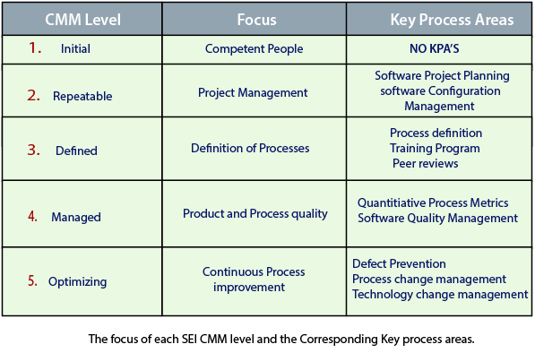
KPAs
KPAs
CMM provides a series of key areas on which to focus to take an organization from one level of maturity to the next. Thus, it provides a method for gradual quality improvement over various stages.

Slide 107
ISO 9000 (CO2)
ISO was published in 1987 as a set of six standards, ISO 8402, ISO 900-1, ISO 9001, ISO 9002, ISO 9003 and ISO 9004-1
It is a consortium of 120 countries to formulate and bring up standardization and published its 9000 series of standard in 1987.
It specify the guidelines for maintaining of quality system.
It focused both operational aspect(process) and organizational aspects(responsibilities, reporting etc.).
ISO-9000 series of standards is a set of document dealing with
quality systems that can be used for quality assurance purposes.

Slide 108
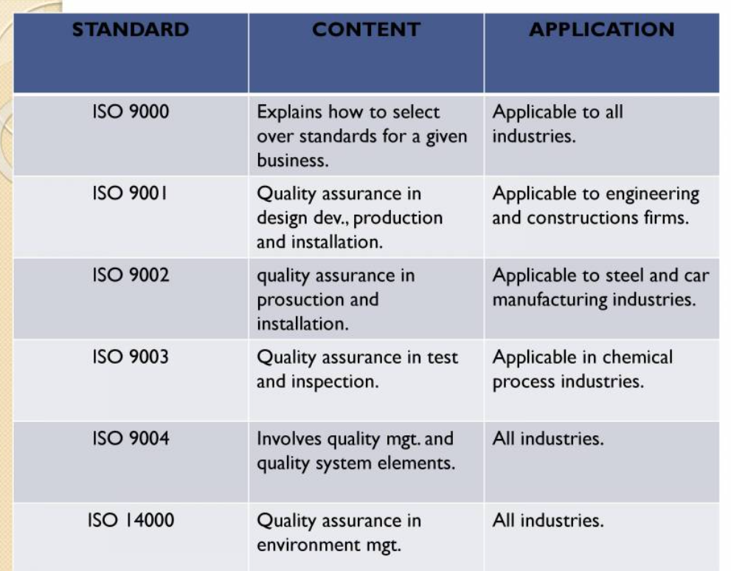
ISO

Slide 109
ISO 9000 (CO2)
ISO-9000 Series: it comprises following standard
ISO 9001: This is the most widely known and comprehensive standard within the ISO 9000 family. It specifies the requirements for a QMS that an organization must demonstrate to achieve certification. ISO 9001 outlines various processes and procedures that organizations must establish and maintain to ensure quality across all aspects of their operations.
ISO 9000: This standard provides an overview of the fundamentals and vocabulary used in quality management and certification. It helps organizations understand the concepts and principles underlying ISO 9001 and other related standards.
ISO 9004: Unlike ISO 9001, which focuses on the requirements for certification, ISO 9004 provides guidelines for enhancing performance and improving the efficiency and effectiveness of a QMS. It offers organizations a broader perspective on quality management and continuous improvement.

Slide 110
Key Principles of ISO 9000
Customer Focus: Organizations should understand and meet customer requirements to enhance customer satisfaction.
Leadership: Top management should provide leadership and establish a clear vision and direction for the organization's quality objectives.
Engagement of People: Employees at all levels should be engaged and empowered to contribute to the organization's success.
Process Approach: Organizations should adopt a process-based approach to achieve consistency and effectiveness in their operations.
Continuous Improvement: Continuous improvement should be a constant goal, with processes regularly monitored and refined.
Evidence-Based Decision Making: Decisions should be based on the analysis of data and information to ensure effectiveness and efficiency.
Relationship Management: Organizations should build and maintain mutually beneficial relationships with suppliers and other relevant parties.

Slide 111
Benefits of Implementing ISO 9000
Improved Quality: ISO 9000 helps organizations establish robust processes to ensure consistent quality in products and services, leading to fewer defects and customer complaints.
Enhanced Customer Satisfaction: By meeting customer requirements and delivering high-quality products and services, organizations can enhance customer satisfaction and loyalty.
Increased Efficiency: ISO 9000 encourages organizations to streamline processes and eliminate waste, leading to improved efficiency and reduced costs.
Market Access: ISO 9000 certification can open doors to new markets and opportunities, as many customers and regulatory bodies require suppliers to be ISO 9000 certified.
Competitive Advantage: ISO 9000 certification can differentiate organizations from competitors and serve as a marketing tool to attract customers who prioritize quality and reliability.
Better Risk Management: By adopting a systematic approach to quality management, organizations can identify and mitigate risks more effectively, minimizing potential negative impacts on their operations.

Slide 112
Reasons that Software industry get ISO certification
It is a symbol of customer confidence.
It highlights weakness and suggests correction measure for improvement.
It makes process more focused, efficient and cost effective.
It is a motivating factor for business organization.
It helps to designing high quality repeatable s/w product.
It facilitates the development of optimal processes and total quality measurement.
It emphasizes the need of proper documents.

Slide 113
Steps to get Certification
Evaluation of Existing Quality Procedures.
Initiating Corrective Actions : If the company (ISO Steering Team) finds deficiencies in the existing quality procedures, then there is a need to correct such deficiencies. Corrective Action may include investigating causes of non – conforming products and identifying corrective action to prevent recurrence.
Preparation of Quality Assurance Programme : the strategies, procedures, and resources necessary to ensure that products or services meet quality requirements.
Preparation of Quality Manual : is a document that outlines the organization's quality management system, including its policies, objectives, procedures, and responsibilities.
Selection of Certification Agency : The company must select an agency to provide ISO 9001 certification. The company may select Bureau of Indian Standards (BIS) or a foreign accredited agency.

Slide 114
Steps to get Certification
Pre – assessment Meeting :a pre-assessment meeting is held between the company's ISO steering team and the certification agency. This meeting aims to clarify expectations, discuss the audit process, and address any concerns or questions regarding the certification process.
Preliminary Visit : certification agency may conduct a preliminary visit to the company's facilities to familiarize themselves with the organization's operations, processes, and QMS documentation.
Actual Assessment Visit: Auditors examine documentation, interview personnel, and observe processes to evaluate the effectiveness and implementation of the QMS.
Certifications : If the company's QMS meets the requirements of ISO 9001 during the assessment, the certification agency issues ISO 9001 certification.
Surveillance: the certification agency conducts regular surveillance audits to ensure ongoing compliance with ISO 9001 standards. These audits verify that the company continues to maintain and improve its QMS over time.

Slide 115
Faculty Video Links, Youtube & NPTEL Video Links and Online Courses Details
https://nptel.ac.in/courses/106/105/106105182/
https://www.youtube.com/watch?v=crz9WmoUoKc
https://www.youtube.com/watch?v=rKG7mgVFCTM
https://www.youtube.com/watch?v=WjwEh15M5Rw

Slide 116
Daily Quiz
1) Which one is not a step of requirement engineering?
(a) Requirements elicitation (b) Requirements analysis
(c) Requirements design (d) Requirements documentation
2) Requirements elicitation means
(a) Gathering of requirements (b) Capturing of requirements
(c) Understanding of requirements (d) All of the above
3) SRS stands for
(a) Software requirements specification (b) System requirements specification
(c) Systematic requirements specifications (d) None of the above
4) SRS document is for
(a) “What” of a system? (b) How to design the system?
(c) Costing and scheduling of a system (d) System’s requirement.
5) Requirements review process is carried out to
(a) Spend time in requirements gathering (b) Improve the quality of SRS
(c) Document the requirements (d) None of the above

Slide 117
Daily Quiz
6) Which one is not a type of requirements?
(a) Known requirements (b) Unknown requirements
(c) Undreamt requirements (d) Complex requirements
7) Which one is not a requirements elicitation technique?
(a) Interviews (b) The use case approach
(c) FAST (d) Data flow diagram.
8) Context diagram explains
(a) The overview of the system (b) The internal view of the system
(c) The entities of the system (d) None of the above
9) Outcome of requirements specification phase is
(a) Design Document (b) SRS Document
(c) Test Document (d) None of the above
10) IEEE standard for SRS is:
(a) IEEE Standard 837-1998 (b) IEEE Standard 830-1998
(c) IEEE Standard 832-1998 (d) IEEE Standard 839-1998

Slide 118
MCQ
Which one is not a step of requirement engineering?
Requirements elicitation
Requirements analysis
Requirements design
Requirements documentation
SRS stands for
Software requirements specification
System requirements specification
Systematic requirements specifications
None of the above
SRS document is for
“What” of a system?
How to design the system?
Costing and scheduling of a system
System’s requirement.

Slide 119
MCQ
Context diagram explains
The overview of the system
The internal view of the system
The entities of the system
None of the above
DFD stands for
Data Flow design
Descriptive functional design
Data flow diagram
None of the above

Slide 120
MCQ
Which is one of the most important stakeholder from the following ? a) Entry level personnel b) Middle level stakeholder c) Managers d) Users of the software
The SRS document is also known as _____________ specification. a) black-box b) white-box c) grey-box d) none of the mentioned

Slide 121
Glossary Questions
Requirement Engineering Process
Elicitation, Analysis, Documentation
Review and Management of User Needs
Feasibility Study
Information Modelling
Decision Tables
SRS Document
IEEE Standards for SRS

Slide 122
Weekly Assignment
What do you mean by formal and informal review?
What is SRS?
What is the purpose of requirement document?
What do you mean by use case diagram? Prepare a use case diagram for student result management system and explain it all use case using different parameter in its template.
What is requirement engineering process? Explain all the methods of requirement elicitation.
What do you mean by data flow diagram? Discuss higher level to low level DFD with suitable diagram.
What is the requirement review process? Explain it with suitable diagram.
How the modularity effect on software cost? Explain with suitable diagram.
What do you mean by SRS? Give the structure of SRS in IEEE format
What do you mean by requirement review?

Slide 123
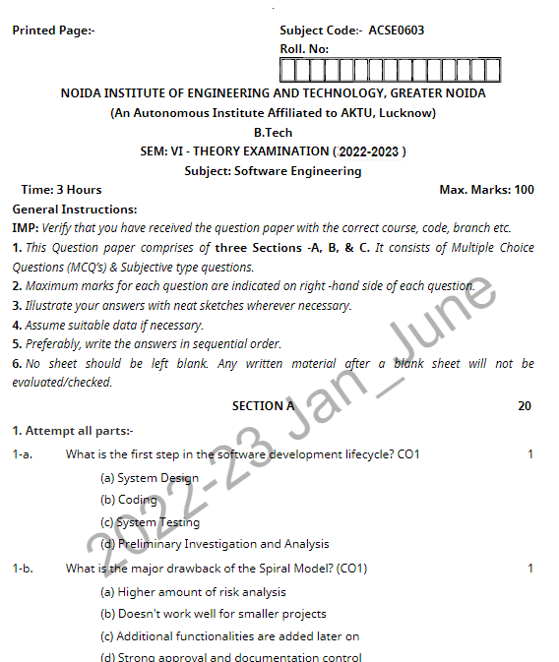
Old Question Papers

Slide 124
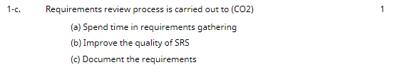
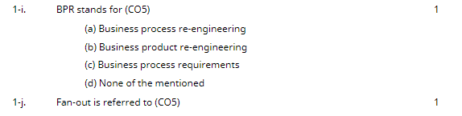
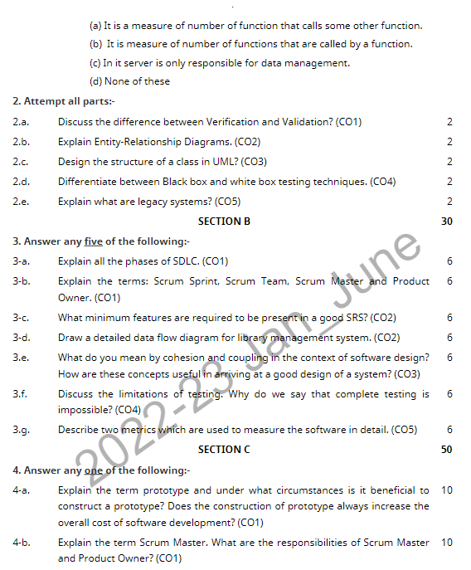
Old Question Papers(CO1)

Slide 125
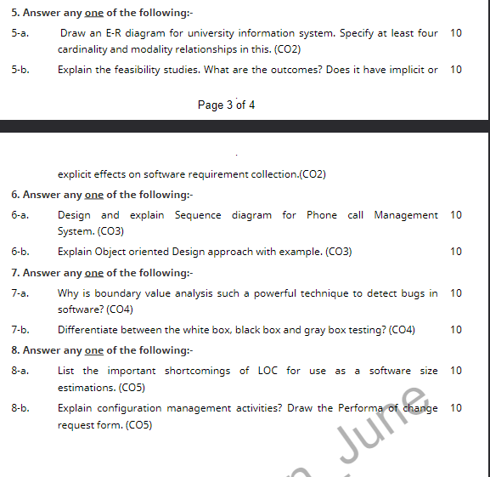
Old Question Papers(CO1)

Slide 126
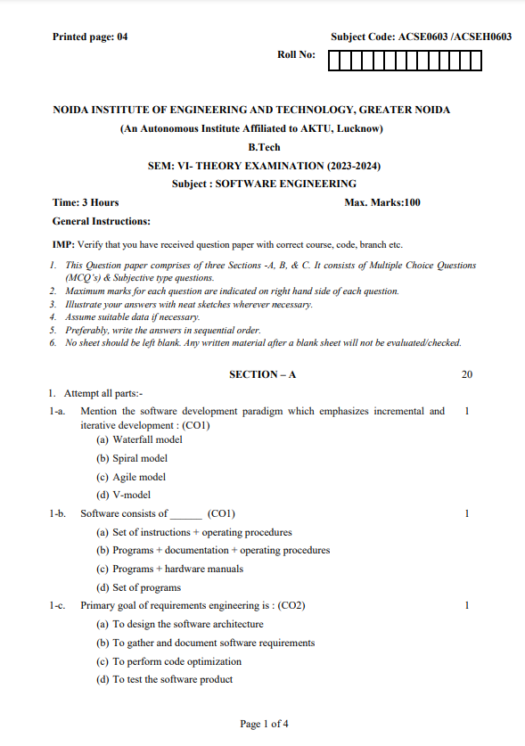
Old Question Papers(CO1)

Slide 127
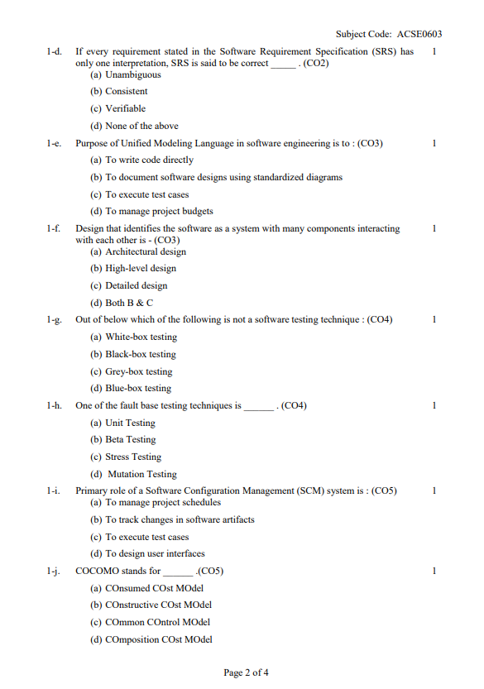
Old Question Papers(CO1)

Slide 128
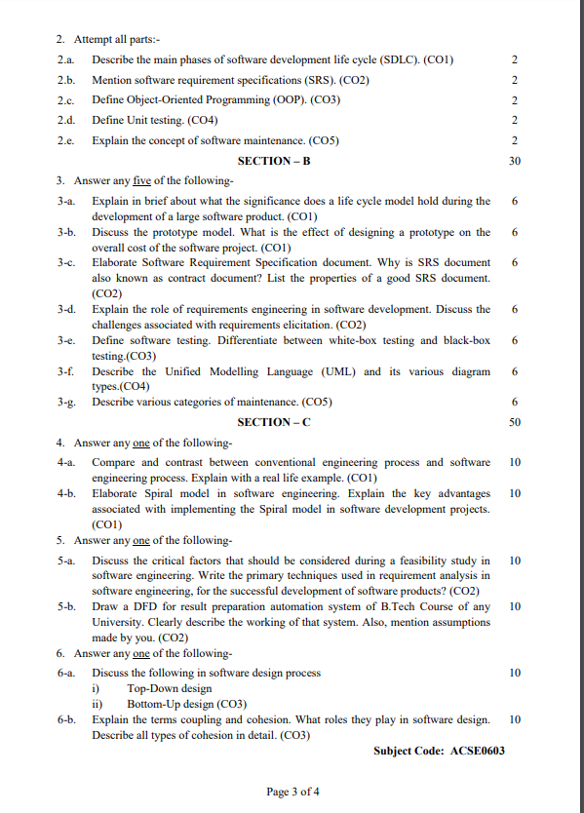
Old Question Papers(CO1)

Slide 129
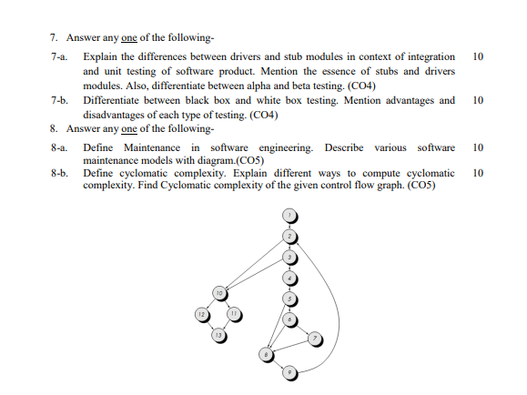
Old Question Papers(CO1)

Slide 130
Expected Questions for University Exam
State any two problems that may associated during Requirement Analysis.
What do you mean by umbrella of activities in Software Quality assurance?
Prepare a ER diagram for hotel management system and specify all attribute of entities.
What are the difference between validation and verification?
What do you mean by data dictionary and decision table? Explain with an example.
What do you mean Software Quality Assurance?
What do you mean by ISO 9000 series?
What do you mean by SEI-CMM model? Explain its all level with suitable diagram in details.

Slide 131
RECAP
Software Requirement Specifications (SRS)
Requirement Engineering Process
Elicitation, Analysis, Documentation
Review and Management of User Needs
Feasibility Study, Information Modeling
Data Flow Diagrams
Entity Relationship Diagrams
Decision Tables
SRS Document
IEEE Standards for SRS
Software Quality Assurance
Verification and Validation
SQA Plans
Software Quality Frameworks
ISO 9000 Models
SEI-CMM Model

Slide 132
References
R. S. Pressman, Software Engineering: A Practitioners Approach, McGraw Hill.
Rajib Mall, Fundamentals of Software Engineering, PHI Publication.
K. K. Aggarwal and Yogesh Singh, Software Engineering, New Age International Publishers.
Pankaj Jalote, Software Engineering, Wiley
Deepak Jain,” Software Engineering: Principles and Practices”,Oxford University Press.
Munesh C. Trivedi, Software Engineering, Khanna Publishing House
N.S. Gill, Software Engineering, Khanna Publishing House

